Slide 1
Lecture 1
Software & Software Engineering
Muhammad Qasim
BSCS (Software Engineering-I) SZABIST-Islamabad

Slide 2
What is Software?
Software is:
Instructions (computer programs) that when executed provide desired features, function, and performance;
Data structures that enable the programs to adequately manipulate information and
Documentation that describes the operation and use of the programs.
BSCS (Software Engineering-I) SZABIST-Islamabad

Slide 3

Question?
What is difference between computer software and computer program?
BSCS (Software Engineering-I) SZABIST-Islamabad

Slide 4
Answer
A computer program is piece of programming code which performs a well defined task where as software includes programming code, its documentation and user guide.
BSCS (Software Engineering-I) SZABIST-Islamabad

Slide 5
Wear vs. Deterioration
Software is developed or engineered, it is not manufactured in the classical sense.
Software doesn't "wear out."
Although the industry is moving toward component-based construction, most software continues to be custom-built.
BSCS (Software Engineering-I) SZABIST-Islamabad

Slide 6

Wear vs. Deterioration
BSCS (Software Engineering-I) SZABIST-Islamabad

Slide 7
Software Categories
S-type (static-type) -
S-type or static-type systems are those that can be described formally in a set of specifications and whose solution is equally well understood. Essentially, these systems are those whose stakeholders understand the problem and exactly know what is needed to resolve it. The static part of these types of systems refers to their distinction of have specifications that do not change.
This software works strictly according to defined specifications and solutions.
For example, calculator
P-type (practical-type) -
P-type systems, or practical-type systems, are those that can be described formally, but whose solution is not immediately apparent. In essences, these are the systems that the stakeholders know what end result is needed, but have no good means of describing how to get there.
This is a software with a collection of procedures.
For example, sketch artist
BSCS (Software Engineering-I) SZABIST-Islamabad

Slide 8
Software Categories
E-type (embedded-type) -
The embedded part of its name refers to the notion that these systems serve to model real-world processes, and through their use, become a component of the world in which they intend to model.
An example of such a highly embedded type system would be the air-traffic control system of an airport; without it, the business of orchestrating the safe departure and arrival of flights would be impossible. In this example, it is easy to see how the system has become component of the real world.
This software works closely as the requirement of real world environment.
For example, Online trading software.
BSCS (Software Engineering-I) SZABIST-Islamabad

Slide 9
Software Applications
system software
application software
engineering/scientific software
embedded software
product-line software
WebApps (Web applications)
AI software
BSCS (Software Engineering-I) SZABIST-Islamabad

Slide 10
Software—New Categories
Open world computing—pervasive, distributed computing
Ubiquitous computing—wireless networks
Netsourcing—the Web as a computing engine
Open source—”free” source code open to the computing community (a blessing, but also a potential curse!)
Also …
  Data mining
  Grid computing
  Cognitive machines
  Software for nanotechnologies
BSCS (Software Engineering-I) SZABIST-Islamabad

Slide 11
Legacy Software
Why must it change?
  software must be adapted to meet the needs of new computing environments or technology.
  software must be enhanced to implement new business requirements.
  software must be extended to make it interoperable with other more modern systems or databases.
  software must be re-architected to make it viable within a network environment.
BSCS (Software Engineering-I) SZABIST-Islamabad

Slide 12
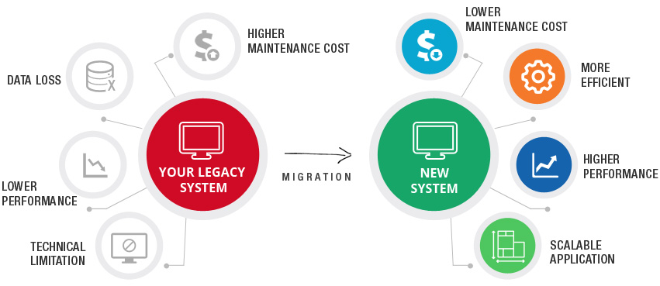
Legacy System
BSCS (Software Engineering-I) SZABIST-Islamabad

Slide 13
Software Engineering Overview
IEEE defines software engineering as:
The application of a systematic, disciplined, quantifiable approach to the development, operation and maintenance of software; that is, the application of engineering to software.
The study of approaches as in the above statement.
Why need of software engineering?
BSCS (Software Engineering-I) SZABIST-Islamabad

Slide 14
Need of Software Engineering
The need of software engineering arises because of higher rate of change in user requirements and environment on which the software is working.
Large software - It is easier to build a wall than to a house or building, likewise, as the size of software become large engineering has to step to give it a scientific process.
Scalability- If the software process were not based on scientific and engineering concepts, it would be easier to re-create new software than to scale an existing one.
Cost- As hardware industry has shown its skills and huge manufacturing has lower down he price of computer and electronic hardware. But the cost of software remains high if proper process is not adapted.
Dynamic Nature- The always growing and adapting nature of software hugely depends upon the environment in which user works. If the nature of software is always changing, new enhancements need to be done in the existing one. This is where software engineering plays a good role.
Quality Management- Better process of software development provides better and quality software product.
BSCS (Software Engineering-I) SZABIST-Islamabad

Slide 15
Characteristics of good software
Well-engineered and crafted software is expected to have the following characteristics:
Operational : This tells us how well software works in operations. It can be measured on:
Budget, Usability, Efficiency, Correctness, Functionality, Dependability, Security, Safety
Transitional: This aspect is important when the software is moved from one platform to another:
Portability, Interoperability, Reusability, Adaptability
Maintenance: This aspect briefs about how well a software has the capabilities to maintain itself in the ever-changing environment:
Modularity, Maintainability, Flexibility, Scalability
BSCS (Software Engineering-I) SZABIST-Islamabad

Slide 16
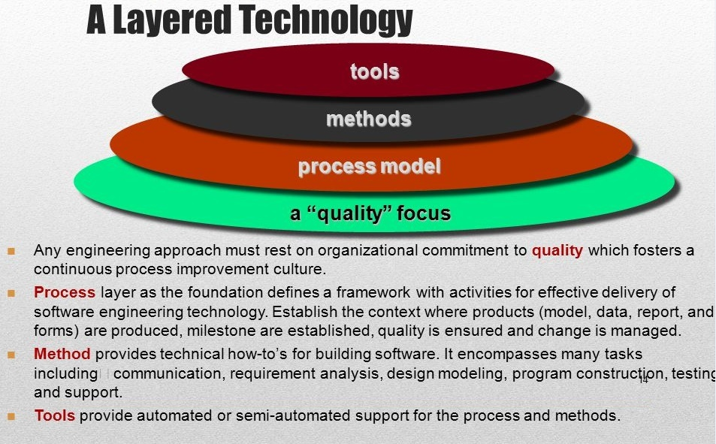
A Layered Technology
BSCS (Software Engineering-I) SZABIST-Islamabad

Slide 17
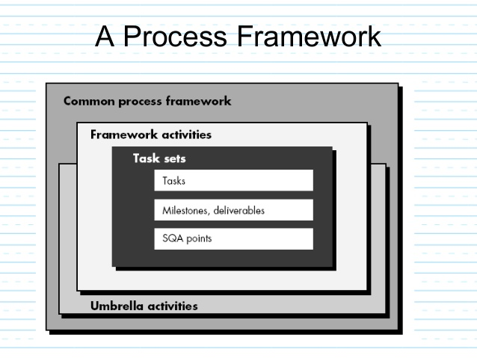
A Process Framework
BSCS (Software Engineering-I) SZABIST-Islamabad

Slide 18
Framework Activities
Communication
Planning
Modeling
  Analysis of requirements
  Design
Construction
  Code generation
  Testing
Deployment
BSCS (Software Engineering-I) SZABIST-Islamabad

Slide 19
Umbrella Activities
Software project management
Formal technical reviews
Software quality assurance
Software configuration management
Work product preparation and production
Reusability management
Measurement
Risk management
BSCS (Software Engineering-I) SZABIST-Islamabad

Slide 20
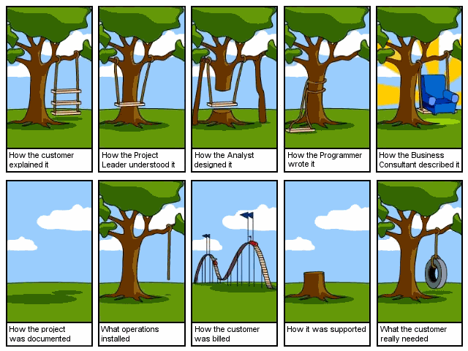
Cartoon
BSCS (Software Engineering-I) SZABIST-Islamabad

Slide 21
Cartoon
BSCS (Software Engineering-I) SZABIST-Islamabad

Slide 22
Cartoon
BSCS (Software Engineering-I) SZABIST-Islamabad

Slide 23
Cartoon
BSCS (Software Engineering-I) SZABIST-Islamabad

Slide 24
Cartoon
BSCS (Software Engineering-I) SZABIST-Islamabad

Slide 25
Cartoon
BSCS (Software Engineering-I) SZABIST-Islamabad

Slide 26
Cartoon
BSCS (Software Engineering-I) SZABIST-Islamabad

Slide 27
Cartoon
BSCS (Software Engineering-I) SZABIST-Islamabad

Slide 28
Cartoon
BSCS (Software Engineering-I) SZABIST-Islamabad

Slide 29
Cartoon
BSCS (Software Engineering-I) SZABIST-Islamabad

